Slide 1
Study of Compressed Emulsions
Project by - Aditya Hardikar
Supervisor - Jasna Brujic

Slide 2
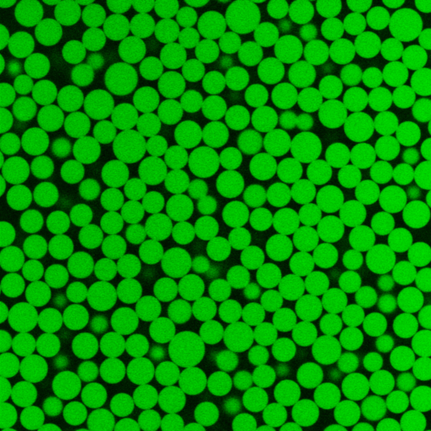
Compressed Emulsions
Confocal Images (z-stack)
Deformable spheres (squishy)
Polydisperse
Random Close Packing
Normal force due to compression
Data from the Brujic Group

Slide 3
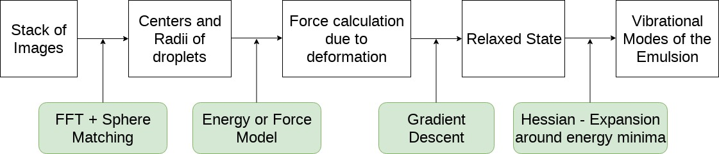
Overall Scheme

Slide 4
Objective
Sources of Error
State ‘observed’ to be in equilibrium
Make the force on each droplet equal 0
Correction by finding new positions / radii
Experimental
Calculating center positions and radii
Force model / Assumptions
Physical (?)

Slide 5
Overall Scheme

Slide 6
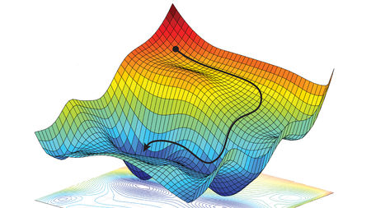
Gradient Descent
Take steps in the direction of decreasing energy / Force
Stop at the minimum
Batch Descent - Simultaneous Update
Rate 𝛂
ALEXANDER AMINI, DANIELA RUS. MASSACHUSETTS INSTITUTE OF TECHNOLOGY, ADAPTED BY M. ATAROD/SCIENCE

Slide 7
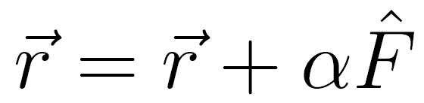
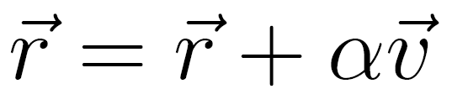
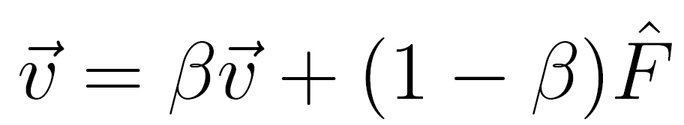
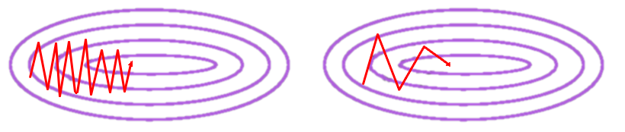
Speeding up the Gradient Descent
Simple Gradient Descent Descent with Momentum
http://dsdeepdive.blogspot.com/2016/03/optimizations-of-gradient-descent.html

Slide 8
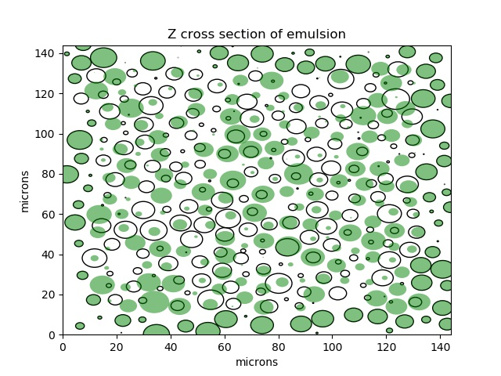

Experimental Data
Polydisperse
Original Position
Relaxed Position
?
?
?
?

Slide 9
Test Cases / Results

Slide 10
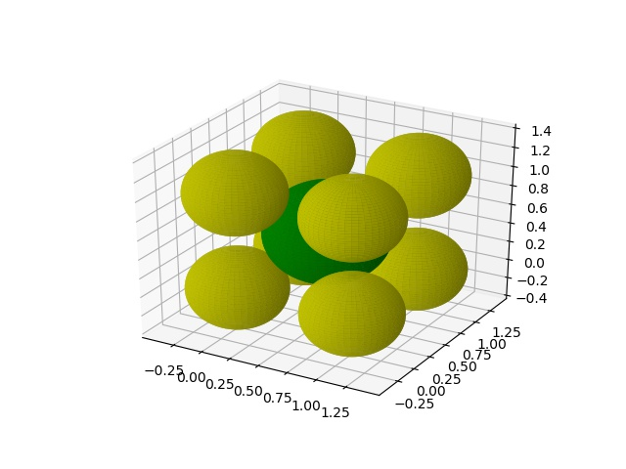
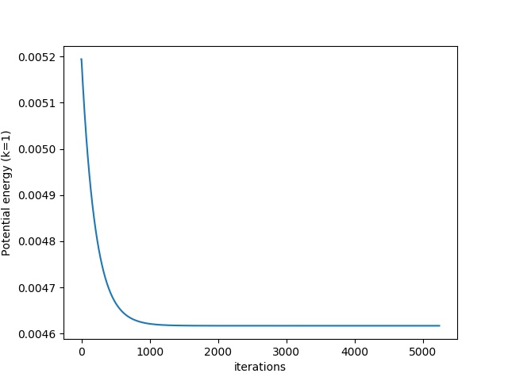
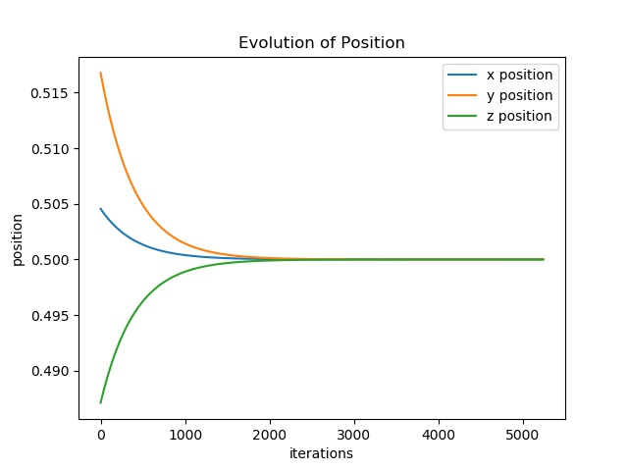
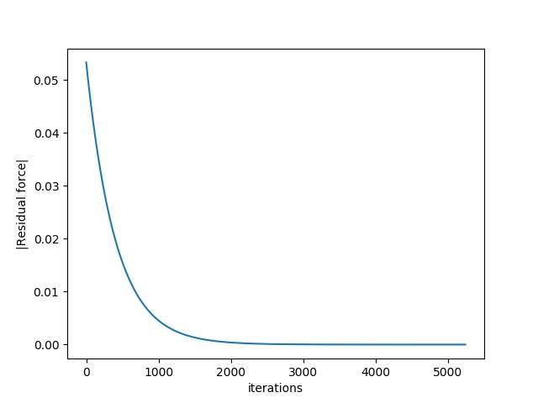
Test 1 : BCC unit cell
Tested for different radii Harmonic Potential
Displaced from center
Returns to the center
a = 1
Evolution of potential energy
Evolution of residual force

Slide 11
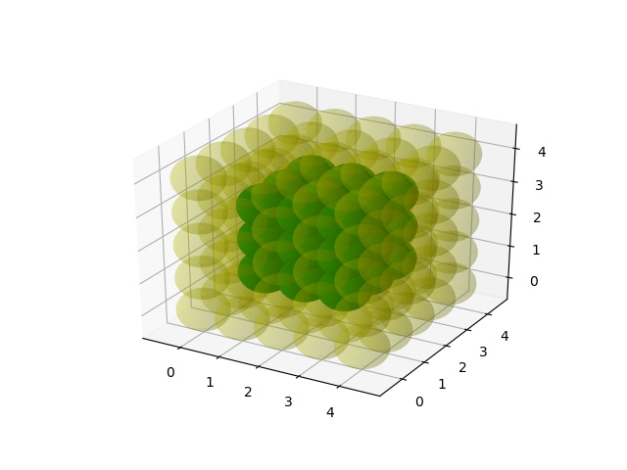
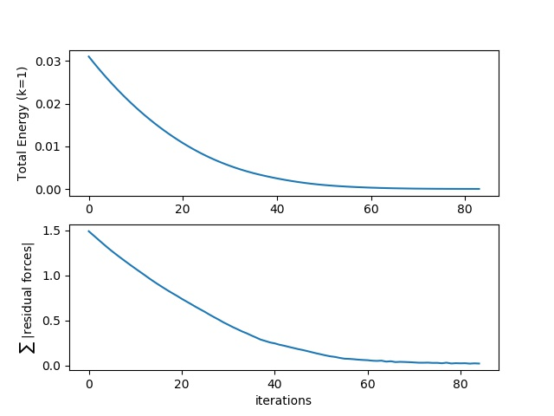
Test 2: 5x5x5 Cubic Lattice
Radii = 0.5*a (just touching)
Harmonic Potential
Displace from lattice points - Relaxation to lattice sites
a = 1
Potential energy
Sum of all residual forces

Slide 12
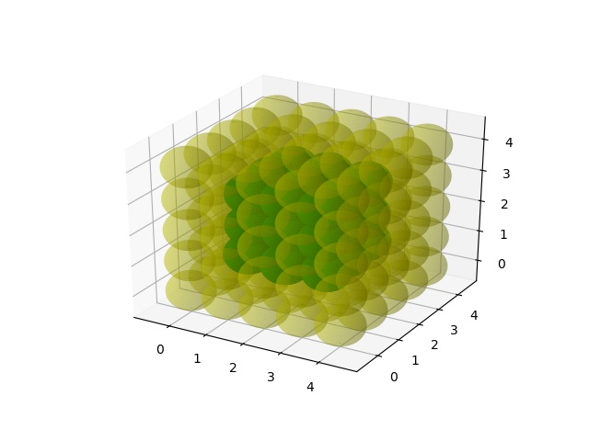
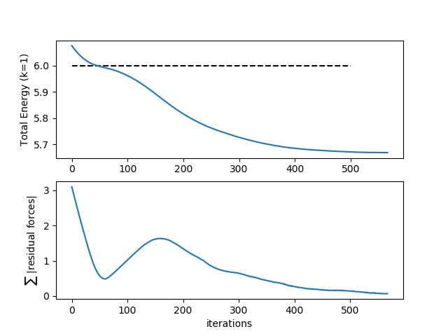
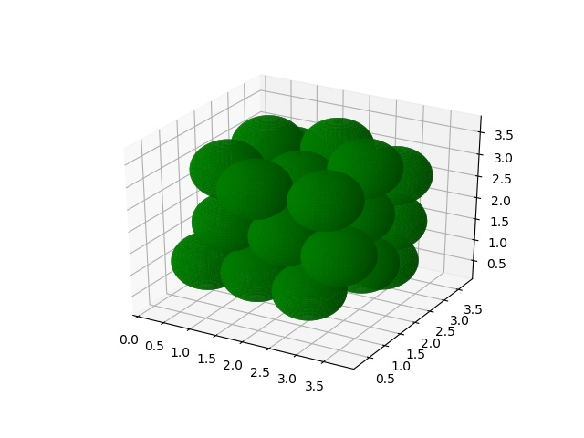
Test 2: 5x5x5 Cubic Lattice
Radii = 0.6*a Harmonic Potential
Start at lattice points - Relaxation NOT to lattice sites!
Potential energy
--- Energy at lattice sites
Sum of all residual forces

Slide 13
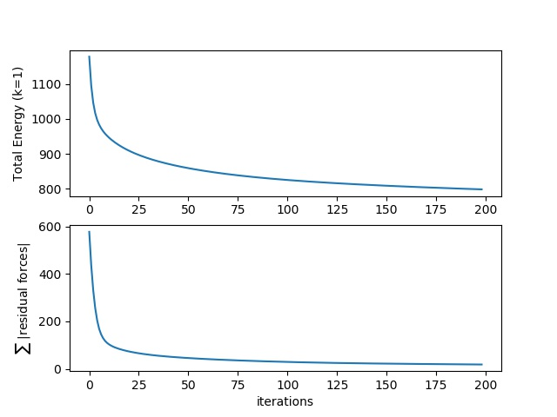
Experimental Data
Polydisperse, Harmonic Potential
Original Position
Relaxed Position
Potential energy
Sum of all residual forces

Slide 14
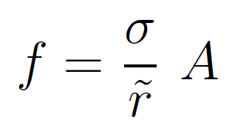

Area dependent potential: Better approximation
h
r1
r2
h
A
x
J. Brujic. Experimental study of stress transmission through particulate matter. Cambridge: University of Cambridge, 2004.

Slide 15
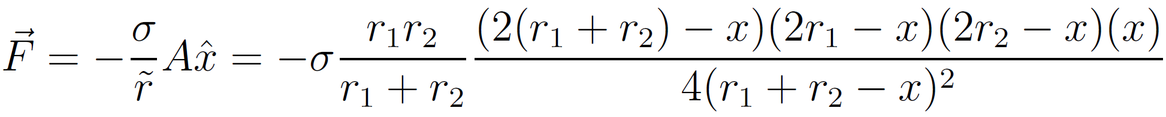
Area dependent potential: Better approximation
r1
r2
h
x
https://www.integral-calculator.com

Slide 16
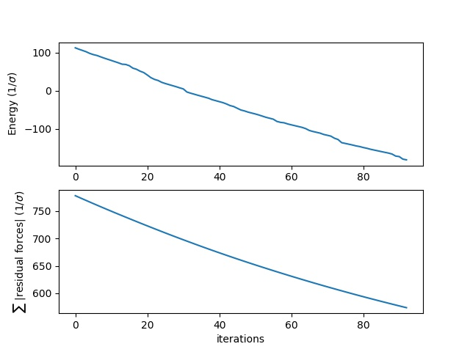
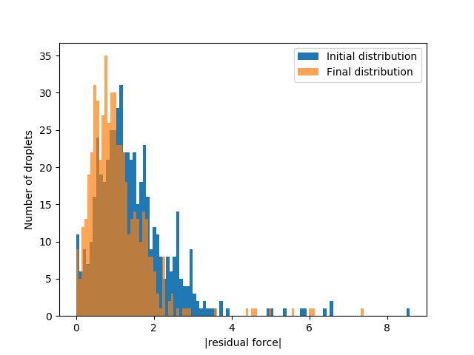
Experimental Data
Area dependent potential

Slide 17

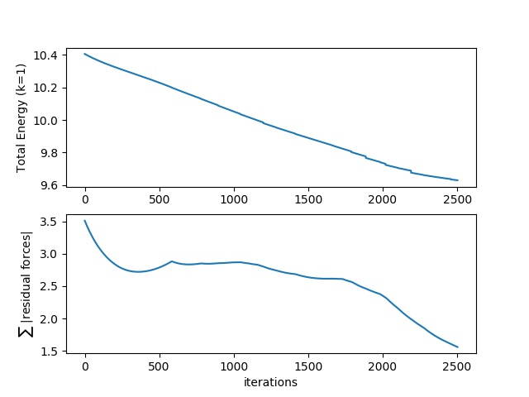
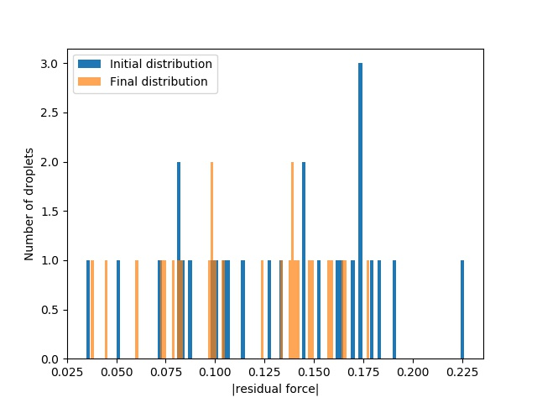
One step simpler: 5x5x5 lattice
Polydisperse, Area dependent potential

Slide 18
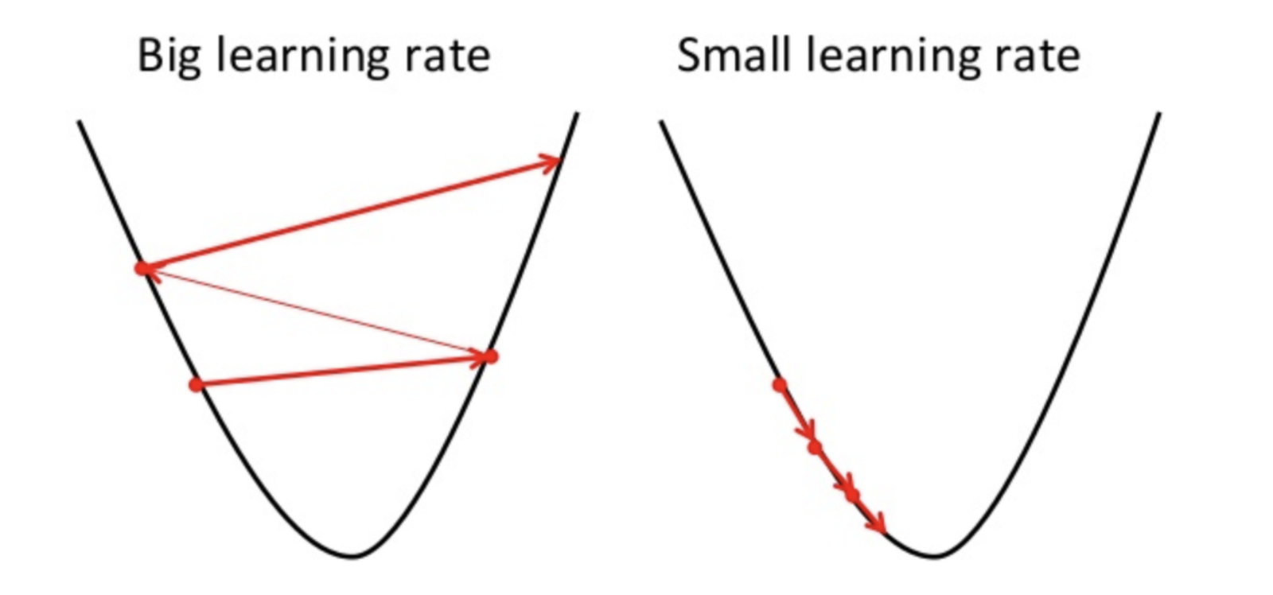
Troubleshooting: Area dependent potential
Chains of particles, monodisperse✓, polydisperse ✓
Unit BCC cell, monodisperse✓, polydisperse ✓
5x5x5 lattice monodisperse✓
5x5x5 lattice polydisperse x
Adaptive Step Size
A

Slide 19
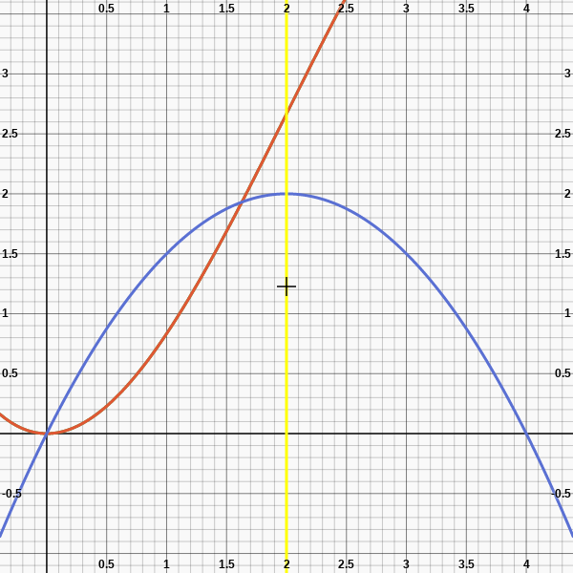
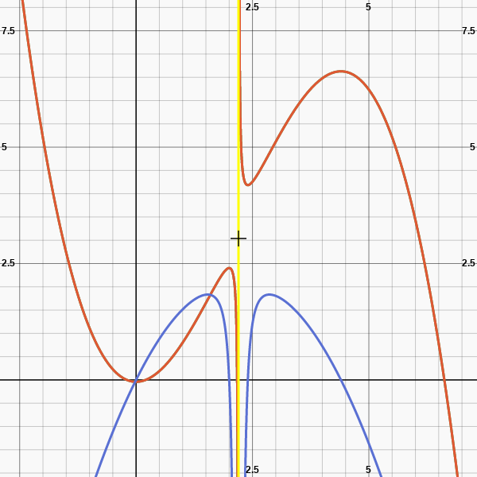
Graph of Potential
-Force
Potential
Singularity
r1 = 1 , r2 = 1, singularity at x= 2
r1 = 1 , r2 = 1.2, singularity at x= 2.2
https://www.integral-calculator.com

Slide 20
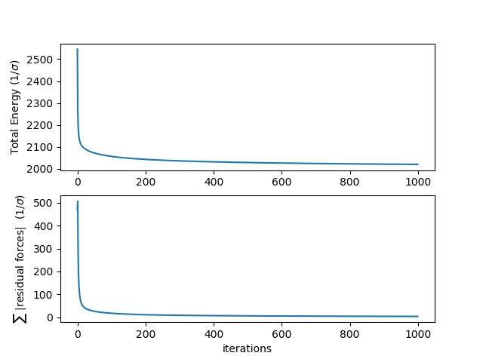
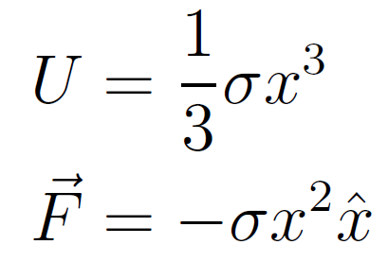
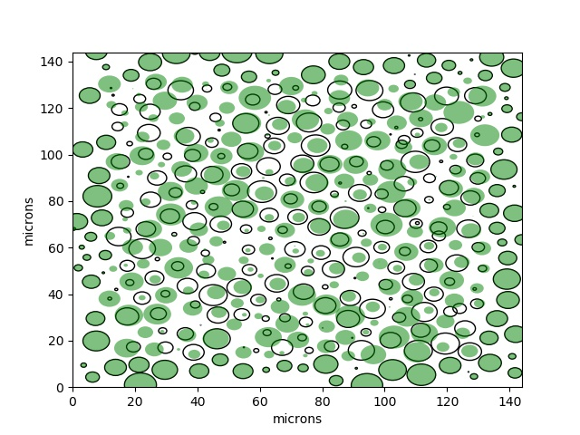
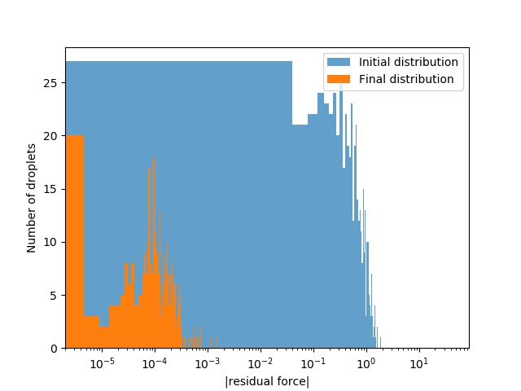
Cubic Potential: Experimental Data
Potential Energy
Original Position
Relaxed Position

Slide 21
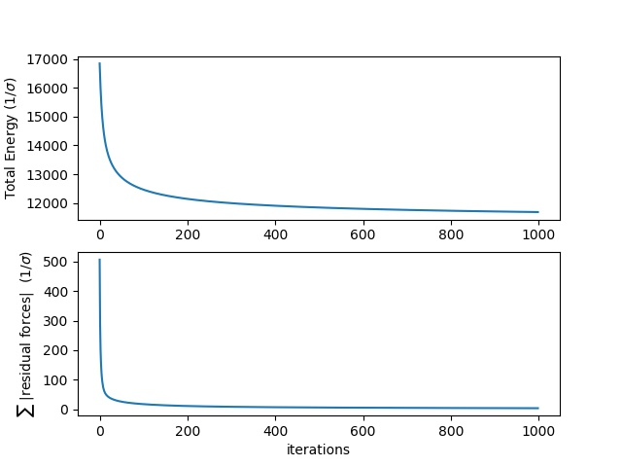
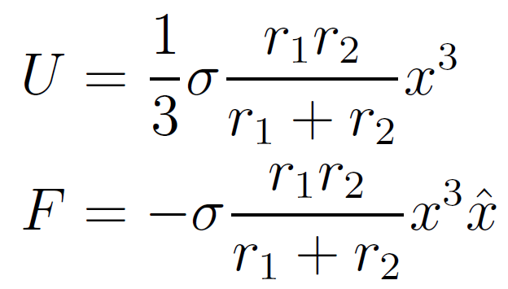
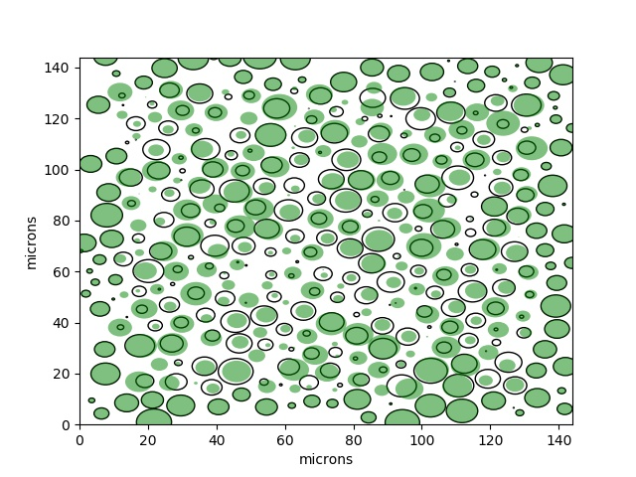
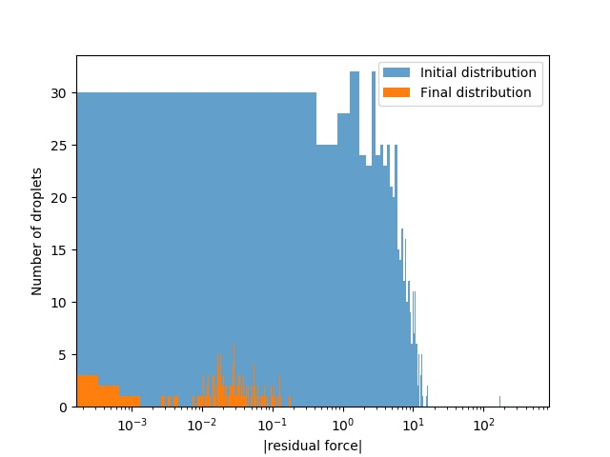
Cubic Potential (Anisotropic): Experimental Data
Potential Energy
Original Position
Relaxed Position

Slide 22
Simple Harmonic Potential
Anisotropic Cubic Potential
Original Position
Relaxed Position

Slide 23
Summary
Similar potentials work
Overlaps are small BUT do singularities play a role in the complicated landscape?
Better Model
Correcting the radii (simultaneous)

Slide 24
Thank You! Inputs?

